Slide 1
COLLEGE of ENGINEERING
Pilot project of
qualified workforce training -
key factor in the activity of companies
ALLPPT.com _ Free PowerPoint Templates, Diagrams and Charts

Slide 2
College of Engineering pilot project of German dual education system in Moldova
Dual education - joint efforts and efficient cooperation between education institution and company of future employees training
College of Engineering: proffesional technical postsecundar nontertiar institution
Established: Government Decision no. 989 of 10.12.2014
Location: Straseni mun. 1, V Crasesu st.
Dual system advantages:
High qualified workforce training with specific technical abilities and general skills as foreign language, computer etc.;
Attractive technical professional programs;
Efficient internship with an authorized supervisor;
Advanced employment opportunities.

Slide 3
College of Engineering
Possibilities for Partners
(private companies)
Possibilities for Students
Best students selection;
Participation to the study programs;
Identical conditions for both theory/ practice;
Authorized supervisor of internship;
High interest for personal development;
Studies on base of dual partnership contract.
Strong link between theory and practice during the studies;
Compact studies of 2 years;
Minimum wage for all years of studies from partner company;
Practical tasks in small groups in a modern workshop;
Real chances of employment afer graduation.
College
Dual Partners

Slide 4
College of Engineering
Admission process
CI
Dual Partners
2. Application request to the
Identified dual parner
Selection of company
List of partners is published
on the College webpage
3. Recommendation letter
4. Submitting all documents,
including recommendation letter
from the partner
5. Signing of contract

Slide 5
Dual partners domestic and foreign companies:
College of Engineering
Draexlmaier Automotive
Sumtomo Electric Bordnetze
Coroplast
GG Cables & Wires
La Triveneta Cavi Development
Introscop
Grip Engineering
Luprom
Whetec

Slide 6
Study year 2018 – 2019 following specialties:
College of Engineering
Industrial technological equipment and accessories
Mechatronics

Slide 7
Renovated facility College of Engineering

Slide 8
Infrastructure:
College of Engineering
Spacious and well equipped study halls
Administrative offices and for teaching staff
Modern workshop (total surface~500 sq.m.)
Dormitory: rooms of 2 persons each, total capacity: 40 persons
Students cafeteria

Slide 9
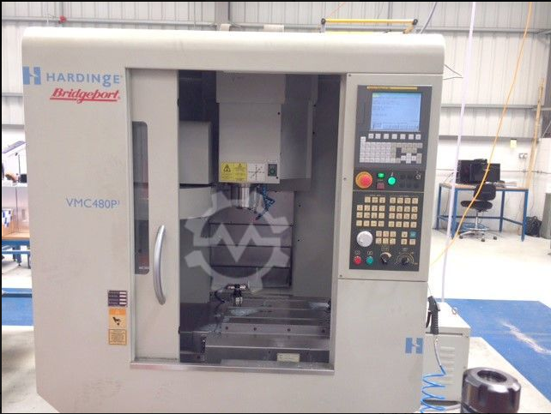
New abilities and competences
Turning and milling sector
CNC lathe + milling machine
CNC milling machine

Slide 10
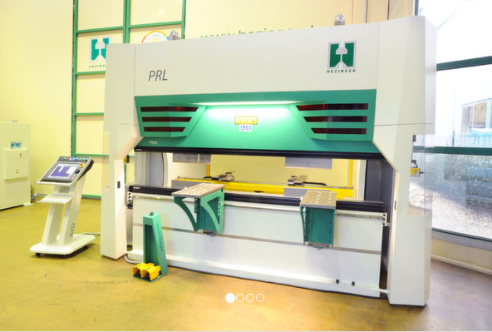
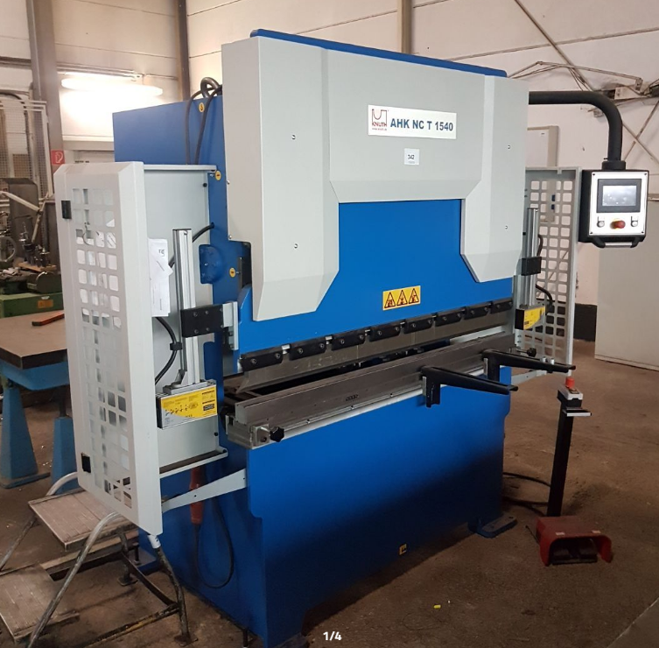
Metalworking (cutting, bending, welding)
CNC metal bending machine
Metal sewing (welding) machine

Slide 11
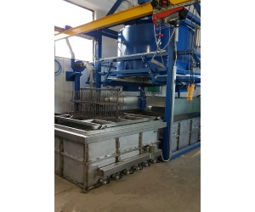
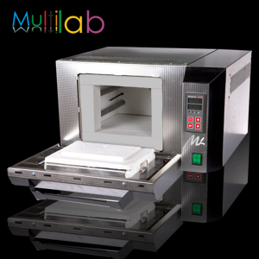
Heat treatment of metal

Slide 12
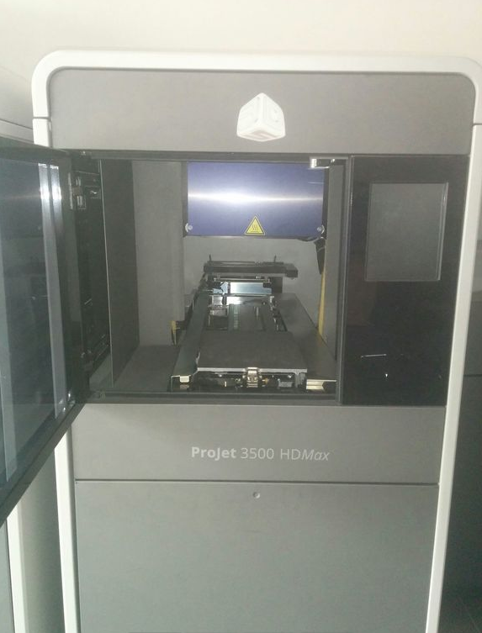
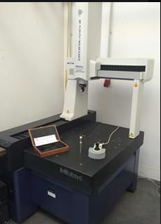
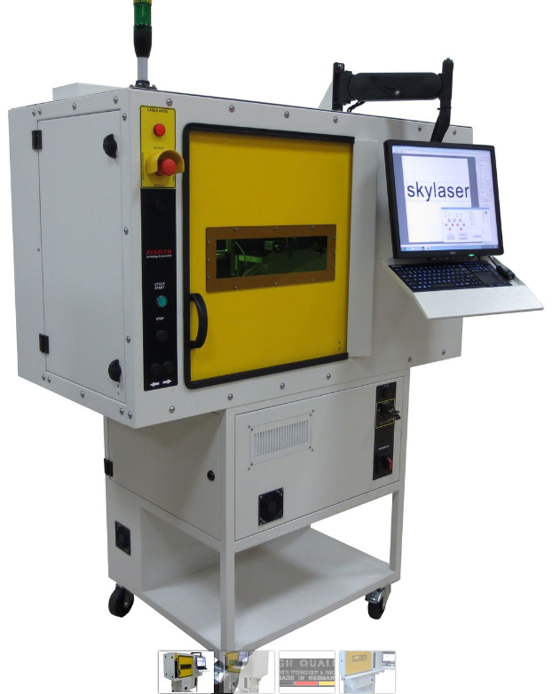
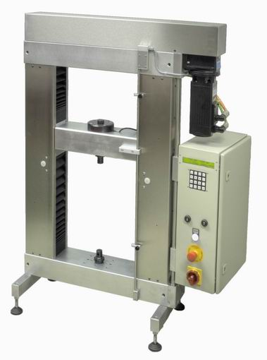
Measurement and testing, printing, engraving
Printing machine
Measurement machine
Testing machine
Engraving machine

Slide 13
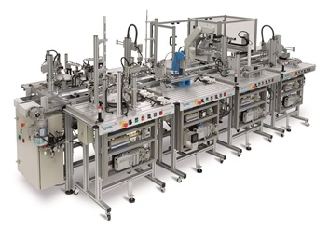
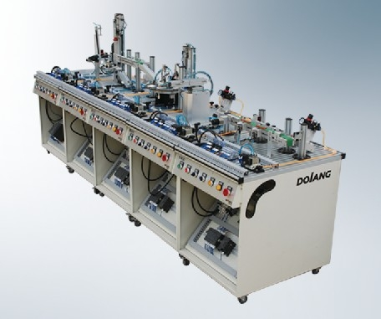
Automatization in construction of machines
Modular, multifunctional production line

Slide 14
Thank You!
???

